Slide 1
GLSL
Dr. Hamish carr & Dr. Rafael Kuffner dos Anjos

Slide 2
Agenda
What is a shader
Shader stages
Writing a shader
COMP 5812M: Foundations of Modelling & Rendering

Slide 3
What is a Shader?
Function called per each element that needs to be processed by the pipeline
For each vertex -> Invoke vertex shader
For each fragment -> Invoke fragment shader
etc
Essentially, the innards of a loop
Applied in parallel to many data

Slide 4
The Vulkan Pipeline

Slide 5

Early Stages
Draw:
Commands enter the pipeline
Input Assembly:
Reads index/vertex buffers
Vertex Shader:
Transforms & processes the vertices
COMP 5812M: Foundations of Modelling & Rendering

Slide 6


Tessellation Stages
Tessellation Control Shader:
Generates patch tessellation commands
Tessellation Primitive Generation:
Breaks patches into smaller patches
Tessellation Evaluation Shader:
Sets attributes for new vertices
Similar to vertex shader
COMP 5812M: Foundations of Modelling & Rendering

Slide 7

Geometric Stages
Geometry Shader
Operates on full primitives
Can change primitive type
Primitive Assembly
Preps vertices for rasterisation
Clip & Cull
Early discard for offscreen primitives
COMP 5812M: Foundations of Modelling & Rendering

Slide 8
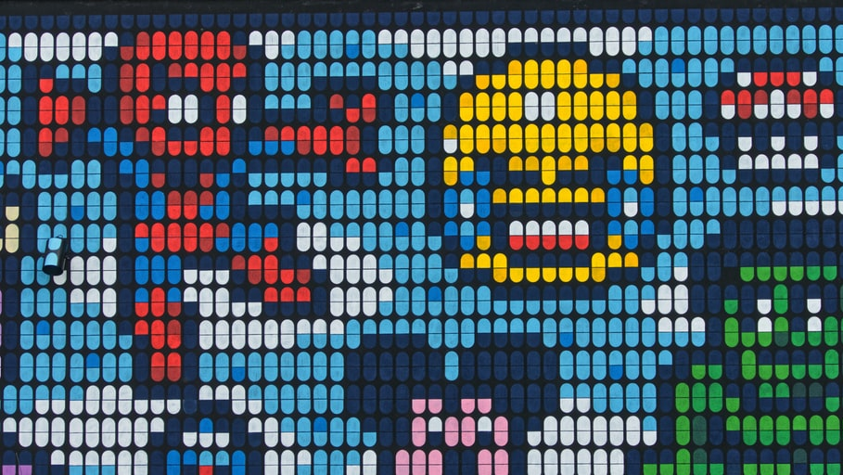
Rasterisation
Many options, but basically fixed function
Rasterises & generates fragments
Computes barycentric coordinates
Uses them to interpolate attributes
COMP 5812M: Foundations of Modelling & Rendering

Slide 9
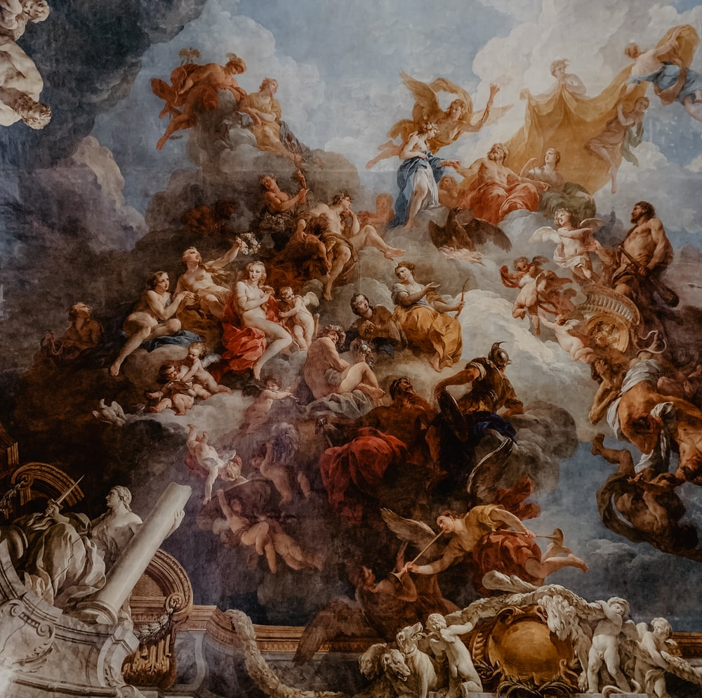
Fragment Stages
Prefragment Operations
Early discard before shading (depth, stencil)
Fragment Assembly
Groups data for fragment shader
Fragment shader
Code for doing shading / rendering
COMP 5812M: Foundations of Modelling & Rendering
COMP 5812M: Foundations of Modelling & Rendering

Slide 10

Fragment Processing
Stages:
Scissor test – use a rectangle to clip rendering
Depth test – use the z-buffer to discard
Stencil test – use a bitmap to clip rendering
These can be performed early or late (default)
Relative to the fragment shader
COMP 5812M: Foundations of Modelling & Rendering

Slide 11

Final Stages
Postfragment Operations
Deferred prefragment operations
If Fragment shader changes data
Color Blending
Updates the Framebuffer
Performs image processing
COMP 5812M: Foundations of Modelling & Rendering

Slide 12
Writing Shaders
A shader is therefore just a small program with a main() routine, known as an entry point
We need to discuss:
Compilation
Language
I/O
COMP 5812M: Foundations of Modelling & Rendering

Slide 13
Shader Compilation
Can be done:
Runtime (GLSL)
Precomputed (CUDA)
Intermediate Code (SPIR-V)
All of which have advantages / disadvantages
COMP 5812M: Foundations of Modelling & Rendering

Slide 14
SPIR-V Compilation
Shaders precompiled to modules (libraries)
Collections of functions with entry points
Each has a name
And a type (which pipeline stage it is for)
Stored as a stream of 4B words
Essentially, an opcode / bytecode like Java
Can be inspected with spirv-dis
COMP 5812M: Foundations of Modelling & Rendering

Slide 15
GLSL
Essentially a dialect of C
With some C++ conveniences
We (like Vulkan) will use GLSL for this and next lecture
Others are similar
Most of the standard library routines built-in
Except memory allocation & I/O

Slide 16
GLSL Types
bool: boolean type, as C++
int/ uint: basic integer type (usually 4B)
float / double: IEEE floating point
float is often a lot faster than double
vec2, vec3, vec4: floating point vectors
integers / doubles also available
mat2, mat3, mat4: matrices

Slide 17
Matrix Types
Float & double are available, no int or bool
Represented in column-major format
Can use m[3] to refer to column 3
All usual arithmetic operations defined
But you’ll still need a library on CPU

Slide 18
I/O
Shaders have no print routines
Makes it harder to debug
Instead, they have shared buffers
Which change from time to time
So they need to be declared explicitly
Based on resources and descriptors
Resource: a variable outside the shader
Descriptor: a bundle of resources
COMP 5812M: Foundations of Modelling & Rendering

Slide 19

Descriptor Set
Set of resources bound as a group
Typically textures, samplers or buffers
Set up as part of the pipeline
Then bound to the inputs of the shader
Push constants are a special case
Variables set directly from command buffer
All others are set by storage in a buffer
COMP 5812M: Foundations of Modelling & Rendering

Slide 20
Shader Memory Access
Shaders can have local variables
These are usually in registers
Anything else is a resource (three kinds):
Uniform Blocks (Read Only)
Texel Buffers (Read Only)
Shader Storage Blocks (Read/Write)
Read Only solves parallel problems

Slide 21

Uniform Blocks
Read-only memory
Shared between all invocations of the shader
Limited size
Usually the fastest memory (ie. cache)
Declared with the uniform keyword

Slide 22
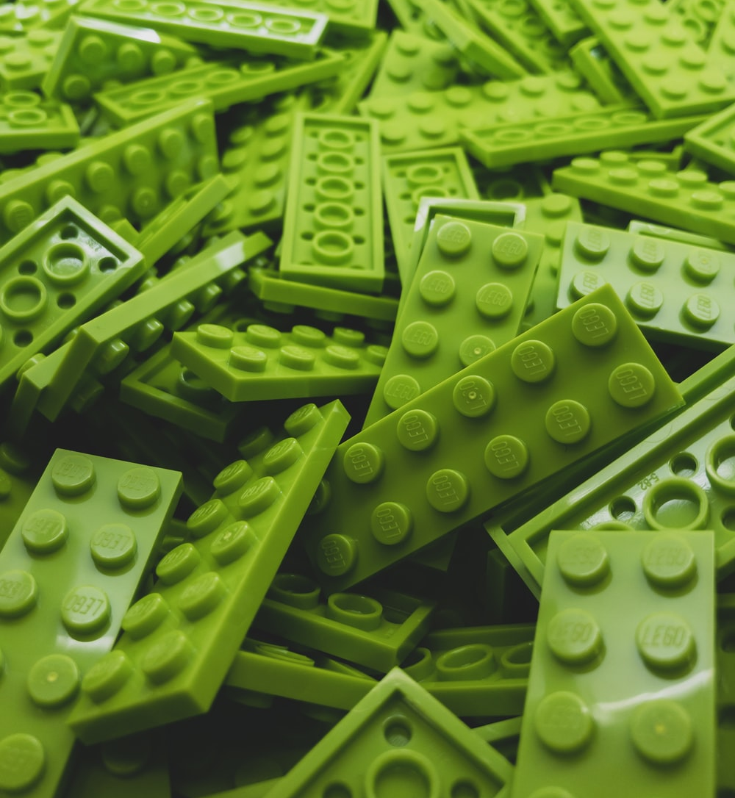
Uniform Buffers
Vertex (shader storage) buffers hold attributes
Values that change for every vertex
Expensive to change (20K vertices => 2MB)
Should be loaded at startup/level load
Uniform buffers are for constants
These are the control variables
Often small in size (< 1KB)
Can be modified every frame

Slide 23
Types of Uniform Data
Transformation matrices
Small, change every frame
Flags & constants to control rendering
Small, may change every frame
Textures
Large (MB+), often constant
Unless they are generated in multipass
COMP 5812M: Foundations of Modelling & Rendering

Slide 24
Transformation Matrices
We may want:
Model matrix
View matrix
Projection matrix
Texture matrix
Shadow matrix
And many others . . .
COMP 5812M: Foundations of Modelling & Rendering

Slide 25
Multiple Matrices
OpenGL had matrix stacks
Useful for animation
But this broke down with skinning
Vertices affected by multiple transformations
E.g. armpit – skin affected by chest & arm
Need to compute an average position
So need access to more than one matrix

Slide 26

Solution
Uniform buffer is untyped (like all buffers)
Store anything you want
You have to specify alignment / offsets
So shader can find the data it needs
But you can pass anything you want
Including 50 different matrices

Slide 27
Uniform Buffer Stages
Control code specifies a descriptor layout
As part of pipeline creation
Then allocates a descriptor set from a pool
And binds the descriptor set for rendering
Layout (again) tells shader how to access it
Very similar to vertex buffer setup
But don’t use a staging buffer (why not?)

Slide 28
Image Buffers (Textures)
Textures are basically constants
Shared between many vertices
So they are passed as uniform buffers
Ideally, no texture swapping during the pass
But they need an extra layer
A sampler
Which takes care of interpolation / filtering
COMP 5812M: Foundations of Modelling & Rendering

Slide 29
Texel Buffers
Read-only
Can convert formats for you
Can do interpolation
Best choice for large arrays of data
Accessed with texelFetch() function
Declared as uniform samplerBuffer

Slide 30
Shader Storage Blocks
Read-write access
Support atomic operations
Therefore often slower
But much larger in size
Declared with buffer keyword
For example, a vertex buffer
Or a frame buffer
COMP 5812M: Foundations of Modelling & Rendering

Slide 31
A Simple Vertex Shader

Slide 32
And a Fragment Shader

Slide 33
Images by
S5 Ben Lambert
S6 Victor
S7 Fakurian Design
S8 Pascal Bernardon
S9 Adrianna Geo
S10Remy Gieling
S11 Hello I’m Nik
S21 Ryan Quintal
S22 Greg Rosenke

